Slide 1


TempTack
Estabillo Co.

Slide 2


About TempTack
  The idea of Virtual and Augmented Reality is not a new thing, but I had this idea wherein what if..
    I can create a smaller and a much better VR Device that functions through neural sensors that can read your memories, or trigger full-body stimulation just by sending electrical impulses direct to the brain?
    This device isn't complicated like the other VR Devices?
    This device can be used as a new and innovative way of learning?
    Instead of wearing a device, you can just attach it?

Slide 3


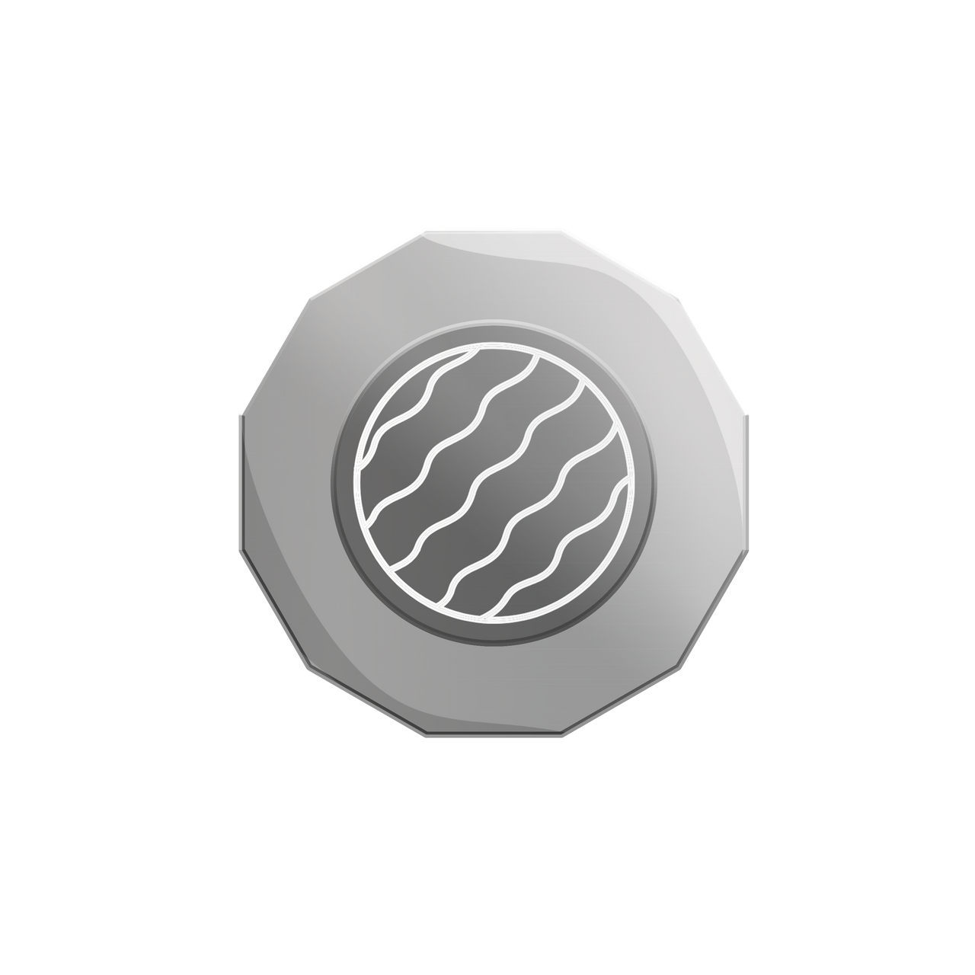
Origin of Name
"TempTack"
"Temp" came from the word Temple which is a part of the head.
"Tack" came from an adhesive reusable putty-like pressure-sensitive adhesive called Blu Tack.

Slide 4


Product Objectives:
  To make Virtual Reality accessible for everyone.
  To create a new, fun and an innovative alternative way of learning.
  To help the lives of the fishermen, farmers, women, and Indigenous people.

Slide 5


  TempTack is an advanced and enhanced Virtual Reality Device.
  TempTack has a sleek and minimalist design.
  TempTack can be accessed using a phone or a computer.
  TempTack is convenient and easy to bring.
  TempTack App offers a lot of different courses and entertainment sources.
  TempTack can be used in a lot of things such as:
    Video Games
    Education
    Social Apps
    Vehicle Simulator
FEATURES:

Slide 6


HOW IT WORKS:
  Install the "TempTack" app in the App store or Play store
  Register and pair your TempTack Device to your phone or computer.
  Choose your desired course or source and then download it.
  Click the downloaded course or source, attach the TempTack Device to your temple, sit down and close your eyes.

Slide 7
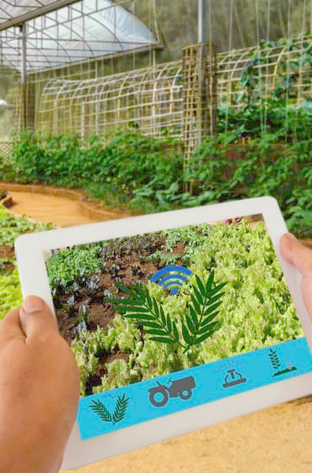
HOW IT WORKS:
  When the TempTack is attached to your temple, it is now connected and functioning through your neural sensors that can read your memories, or trigger full-body stimulation just by sending electrical impulses direct to the brain.
  The user will experience that he/she has been teleported in a different dimension, which in this case a virtual world.
  The experience would be extraordinary because the user is not moving any part of his/her body, the user would just be using their brain.
  The user has the ability to control his/her thoughts, movements, and decision making in that Virtual World without even moving.

Slide 8
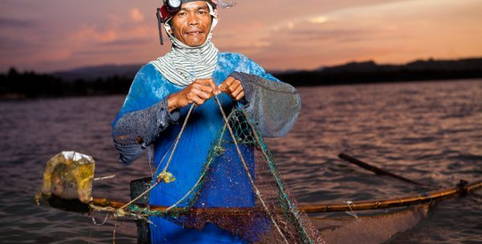



These are the people that inspired me to create TempTack. They are the one's whom I want to dedicate TempTack because I believe that they are the one's who needs it the most.
TempTack offers a lot of courses that could help fishermen and farmers to improve their skills in their chosen field. They could learn a lot of important information related to farming and fishing even without having a formal education. All female users could install and learn the "self-defense course" which can help them to build their confidence and to improve their street awareness. Indigenous Groups could install and learn the"stayin' alive course" which can help them preserve their culture and learn other culture to practice and improve diversity in the Indigenous community.

Slide 9
VISION & MISSION:
The goal in creating TempTack is to make a type of Advanced Technology accessible to everyone where anybody can enjoy and benefit from it; to create a new and innovative way of learning which can be revolutionary in the field of technology and education;
TempTack will provide the finest technology that will support the needs of every user; we will do our best to bring out the best in everybody for them to reach their full capabilities; and to help them think creatively and innovatively.

Slide 10
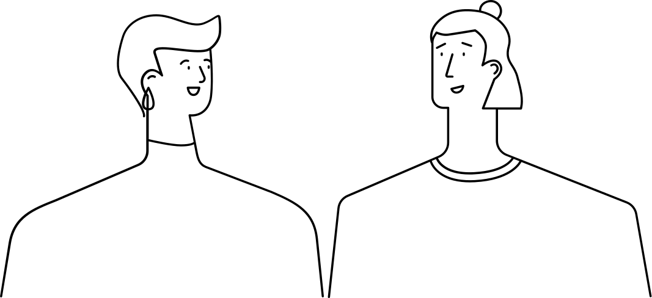

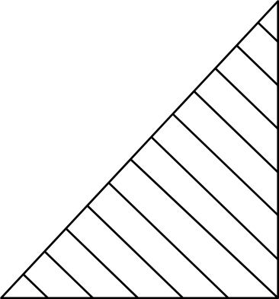
THANK YOU FOR LISTENING!
Estabillo Co.

